Slide 1

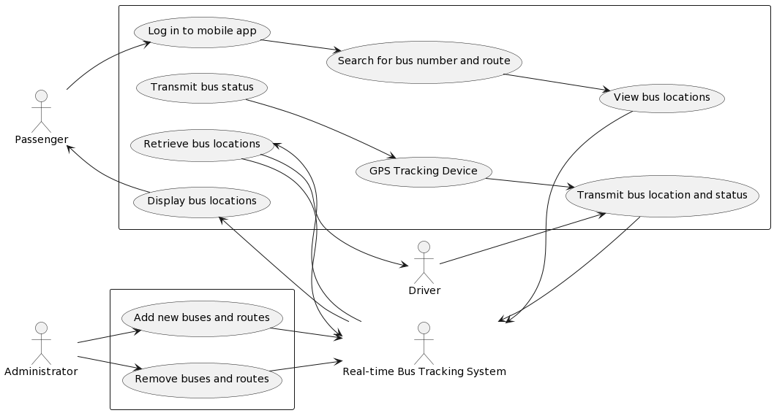
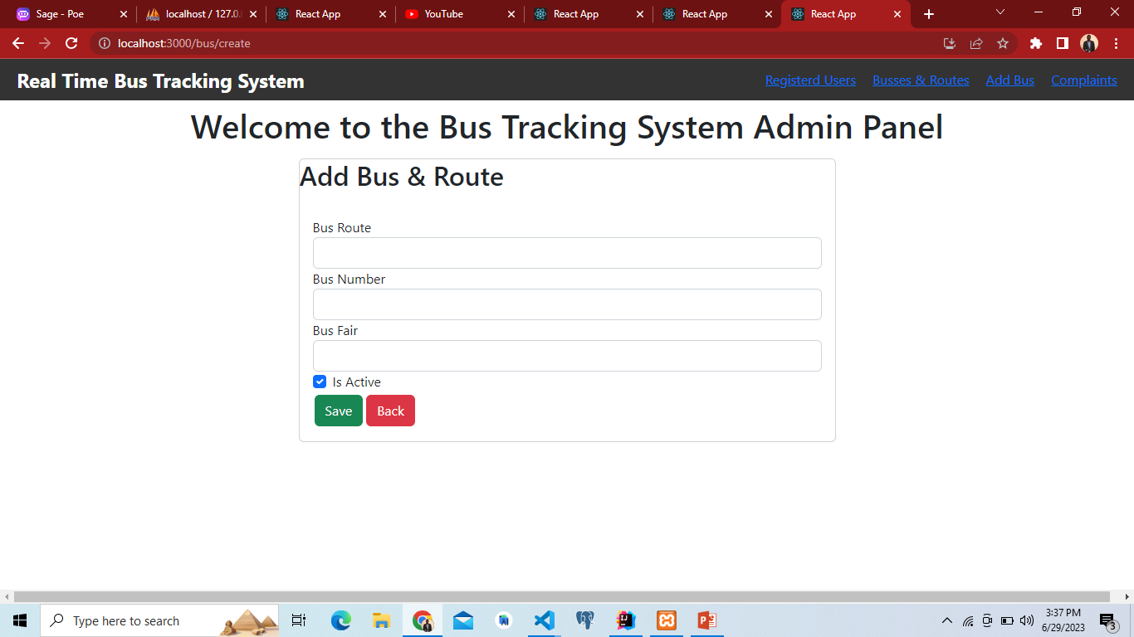
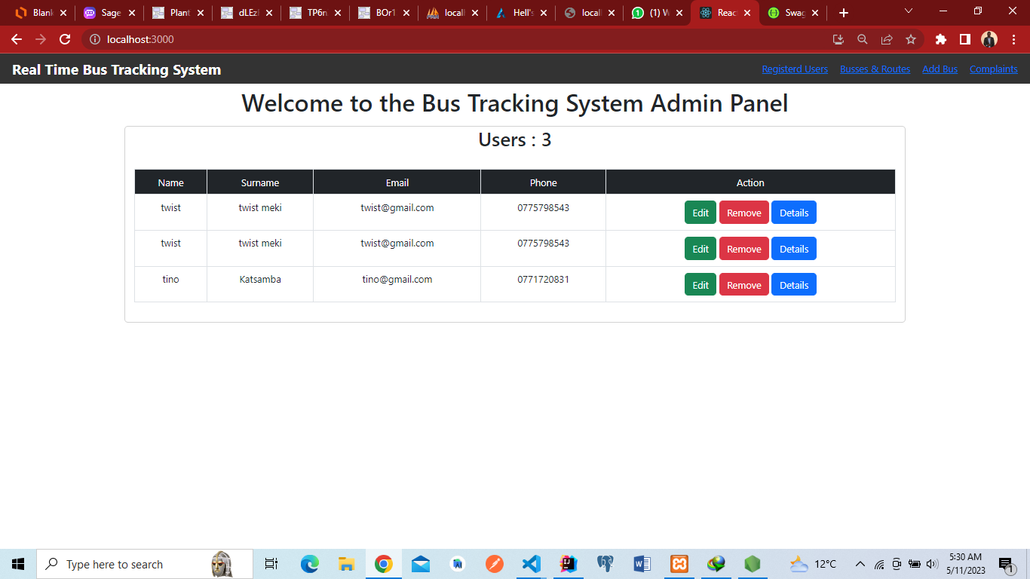
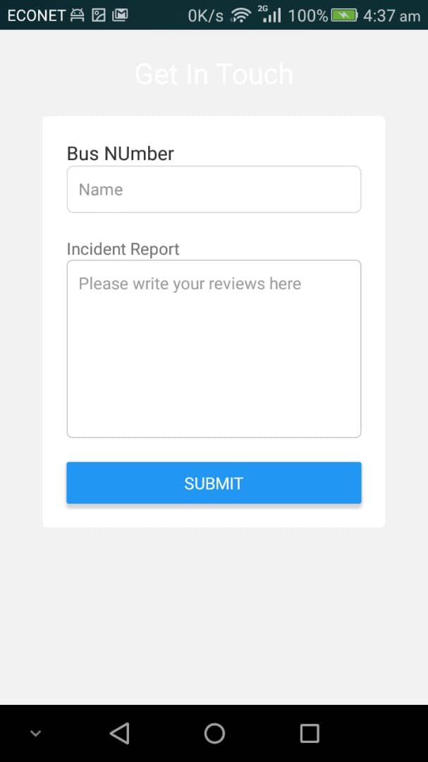
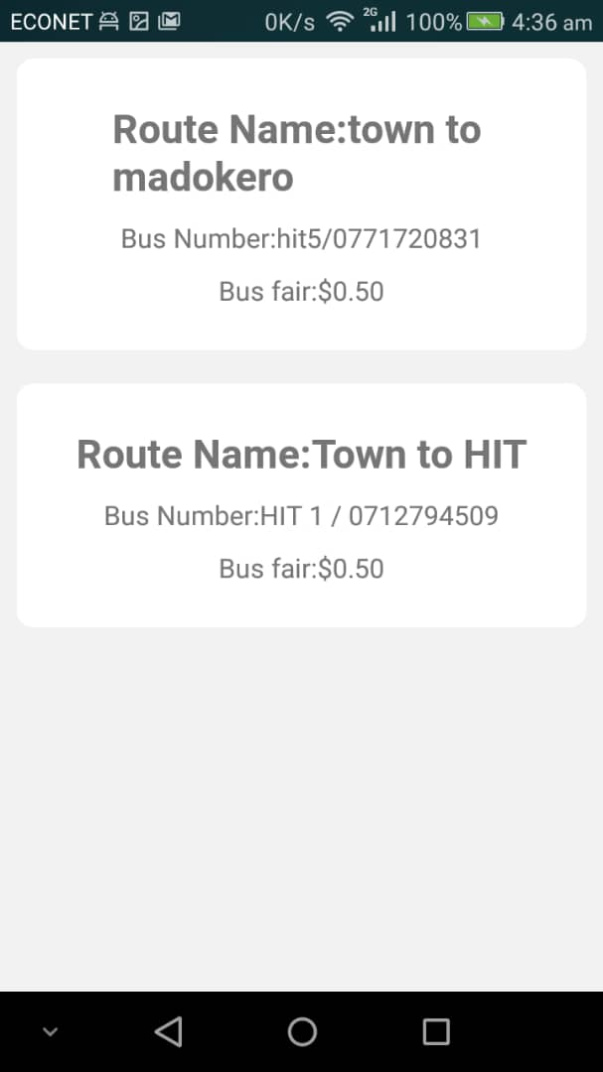
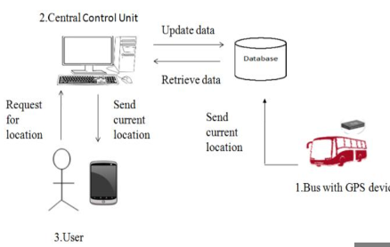
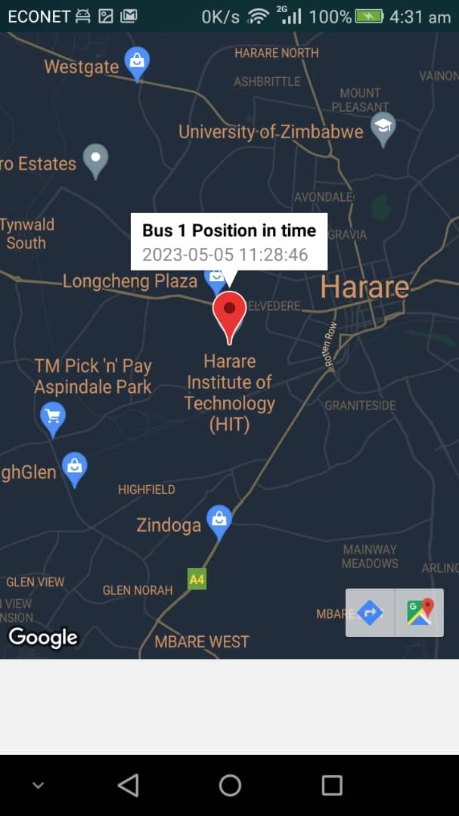
REAL TIME BUS TRACKING SYSTEM
Tinotenda Katsamba - Software Engineering Department
1.0 Abstract
3.0. Problem definition
7.0. Use Case Diagram
Real-time bus tracking systems have become increasingly popular in recent years, as they offer a more efficient and convenient way for commuters to plan their journeys and reduce the time spent waiting for public transportation. This paper proposes a real-time bus tracking system that utilizes GPS and mobile data networks to track the location of buses in real-time. The system allows commuters to access information about the location and estimated arrival time of buses through a mobile application. The proposed system is designed to be scalable, reliable, and easy to use, and it can be implemented in any city with a public transportation system.The system was implemented using GPS and GSM modules. Results from a pilot study show that the system is effective in reducing waiting times and improving the overall commuting experience for users.
Due to the inconsistent and unavailable of bus time tables in bus terminus, commuters have been on many occasions been left stranded.Despite government efforts to ease transport problems by offering subsidized ZUPCO buses on different routes to ease transport costs and provide safe and cheap transport to the commuting public, commuters are still facing a lot of problems in accessing this transport service and in some cases turn to private commuters who overcharge, drive recklessly hence endangering the lives of civilians and in some cases they turn to be criminals who rob ,rape unsuspecting commuters who are desparate to get home especially after a long day work.In most cases commuters spend hours waiting for buses without the slightest hint on when they may come .
4.0. Overview of the developed application
The system works by equipping each bus with a GPS tracking device that sends location data to a central server. The data is then processed and made available to users through an interface that displays the location of the bus on a map, along with estimated arrival times at various stops.
The system also has an offline functionality whereby one can send the text message “location” to a specific bus number saved in their mobile device and a text containing bus location will be sent from the bus which they can open on google maps on their devices.
8.0. Screenshots
2.0. Introduction
In Zimbabwe, a real-time bus tracking system can play a vital role in improving the efficiency and reliability of public transportation. With the challenge of inaccurate public transport timetables faced by many commuters, a real-time bus tracking system can provide valuable data for the general commuters and improve the general transportation system.
Such a system can use GPS and GSM technology to track the location of buses in real-time and provide accurate and up-to-date information on bus routes, schedules, and arrival times to passengers. This can improve the overall passenger experience and help reduce wait times, particularly in urban areas where traffic congestion is a major issue.
Additionally, a real-time bus tracking system can provide valuable data on bus usage patterns, which can be used by municipal authorities to better plan and manage public transportation services. This can include identifying areas with high demand for public transportation services and adjusting routes and schedules accordingly.
Conclusion
In conclusion, the development of a real-time bus tracking system using an ESP8266, GPS, and GSM module is a significant achievement in the transportation industry. This system provides an efficient and reliable way of tracking buses and providing real-time updates to the users. By integrating a mobile app, customers can access the system easily and get accurate information on the location, route, and timing of the buses. The use of GPS and GSM technology ensures that the system is accurate and reliable, while the ESP8266 provides the necessary connectivity and communication between the system and the mobile app.
5.0. Objectives
To design a mobile app
To design a bus tracking device
To send GPS coordinates to customers via text messages
To link the mobile app with the tracking device
Supervisor – Simbai Zindove
6.0. System Overview

